Slide 1

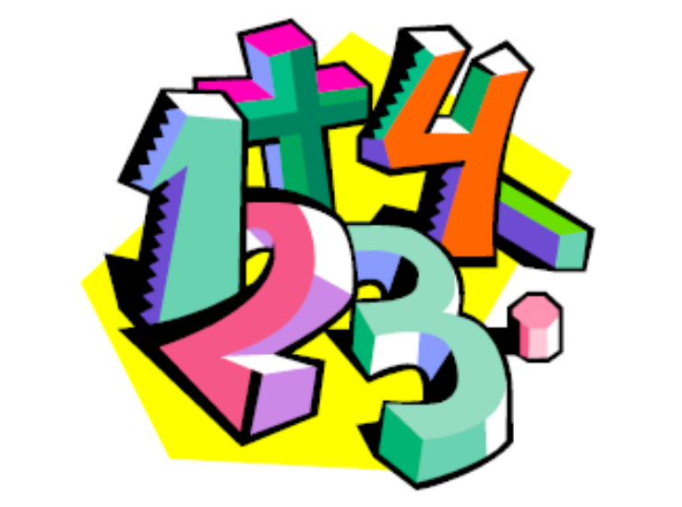
College of Computer and Information Sciences
Department of Computer Science
CSC 220: Computer Organization
Unit 9
Data Representation
For Review

Slide 2
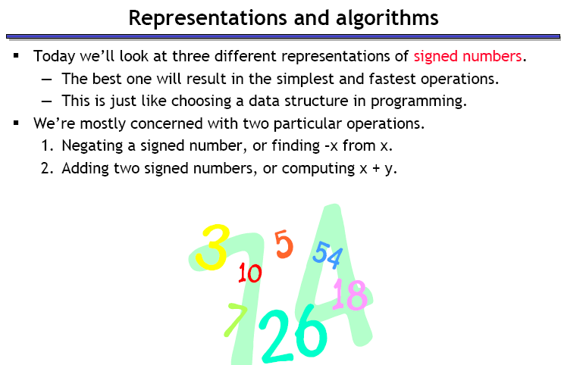
For Review

Slide 3
Unsigned Representation
Represents positive integers.
Unsigned representation of 157:
Addition is simple:
1 0 0 1 + 0 1 0 1 = 1 1 1 0.
position | 7 | 6 | 5 | 4 | 3 | 2 | 1 | 0
Bit pattern | 1 | 0 | 0 | 1 | 1 | 1 | 0 | 1
contribution | 2⁷ |  |  | 2⁴ | 2³ | 2² |  | 2⁰

Slide 4
Advantages and disadvantages of unsigned notation
Advantages:
  One representation of zero
  Simple addition
Disadvantages
  Negative numbers can not be represented.
  The need of different notation to represent negative numbers.

Slide 5
Representation of negative numbers
Is a representation of negative numbers possible?
Unfortunately:
  you can not just stick a negative sign in front of a binary
  number. (it does not work like that)
There are three methods used to represent negative numbers.
  Signed magnitude notation
  One’s complement notation
  Two’s complement notation

Slide 6
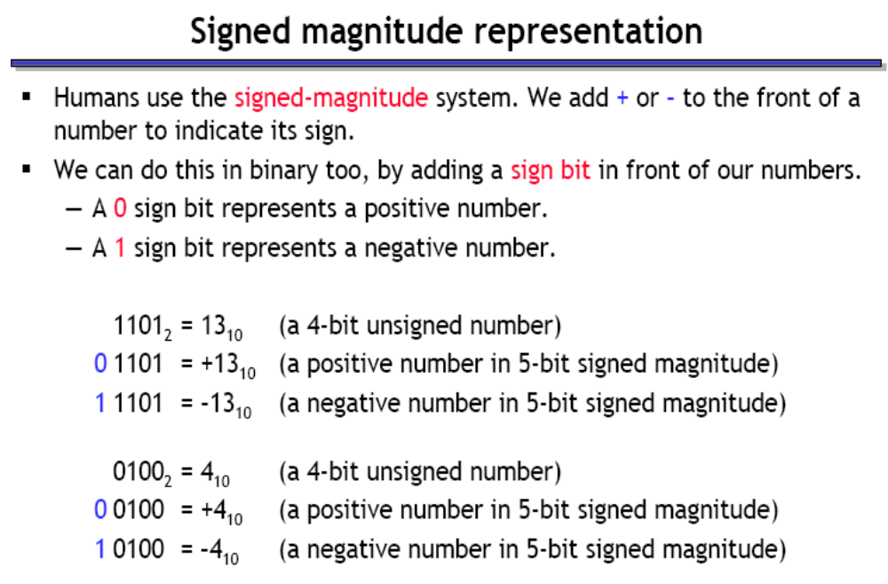
For Review

Slide 7
Example
Suppose 10011101 is a signed magnitude representation.
The sign bit is 1, then the number represented is negative
The magnitude is 0011101 with a value 2⁴+2³+2²+2⁰= 29
Then the number represented by 10011101 is –29.
position | 7 | 6 | 5 | 4 | 3 | 2 | 1 | 0
Bit pattern | 1 | 0 | 0 | 1 | 1 | 1 | 0 | 1
contribution | - |  |  | 2⁴ | 2³ | 2² |  | 2⁰

Slide 8
Exercise 1
37₁₀ has 0010 0101 in signed magnitude notation. Find the signed magnitude of –37₁₀ ?
Using the signed magnitude notation find the 8-bit binary representation of the decimal value 24₁₀ and -24₁₀.
Find the signed magnitude of –63 using 8-bit binary sequence?

Slide 9
Disadvantage of Signed Magnitude
Addition and subtractions are difficult.
Signs and magnitude, both have to carry out the required operation.
They are two representations of 0
    00000000 = + 0₁₀
    10000000 = - 0₁₀
    To test if a number is 0 or not, the CPU will need to see whether it is 00000000 or 10000000.
    0 is always performed in programs.
      Therefore, having two representations of 0 is inconvenient.

Slide 10
Signed Magnitude-Summary
In signed magnitude notation,
    The most significant bit is used to represent the sign.
    1 represents negative numbers
    0 represents positive numbers.
    The unsigned value of the remaining bits represent The magnitude.
Advantages:
    Represents positive and negative numbers
Disadvantages:
    two representations of zero,
    Arithmetic operations are difficult.

Slide 11
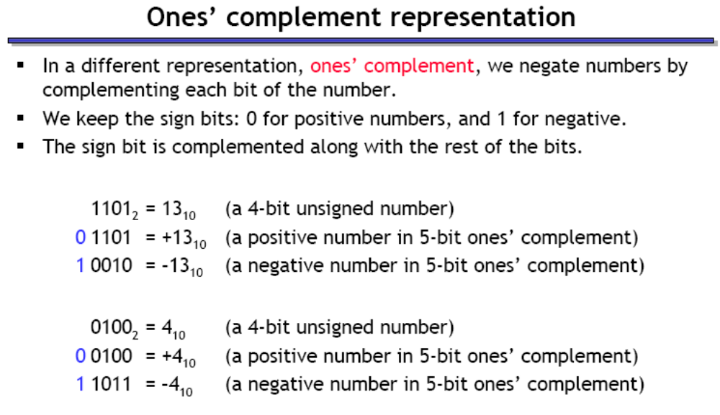

Slide 12
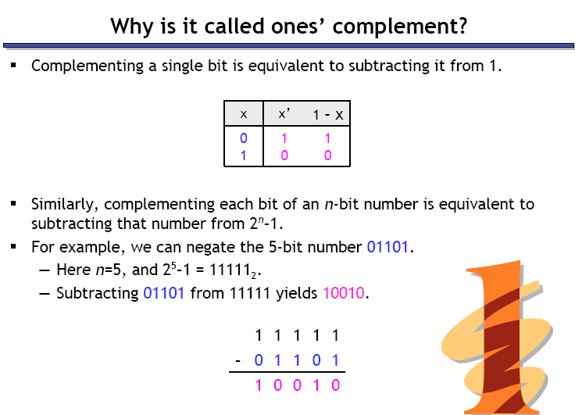
For Review

Slide 13
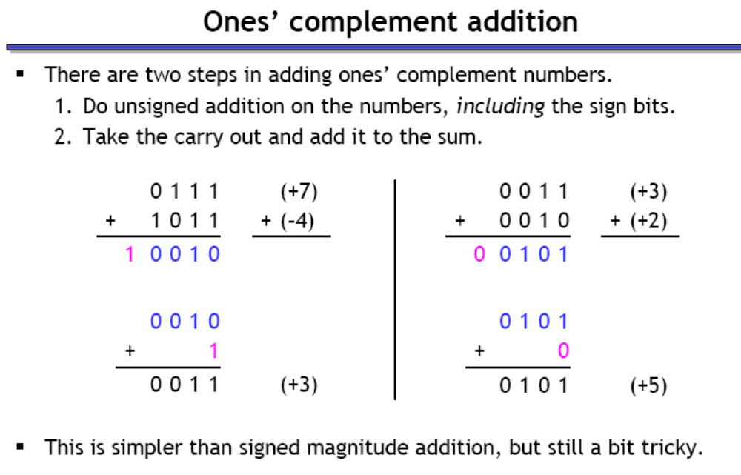

Slide 14
Two’s Complement Notation
The most used representation for integers.
  All positive numbers begin with 0.
  All negative numbers begin with 1.
  One representation of zero
    i.e. 0 is represented as 0000 using 4-bit binary sequence.

Slide 15
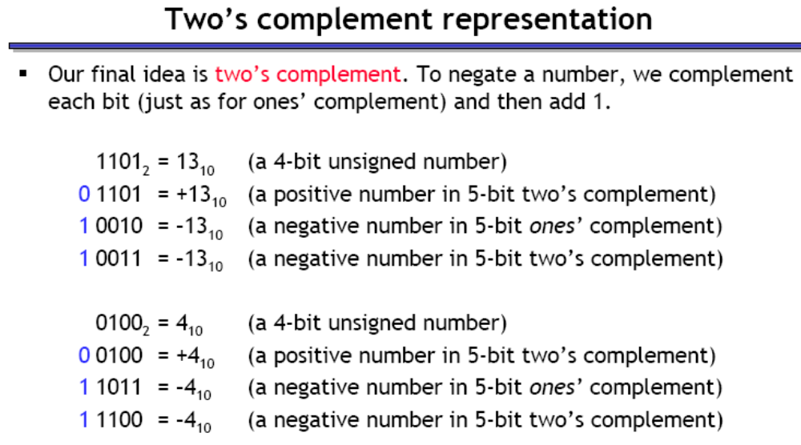

Slide 16
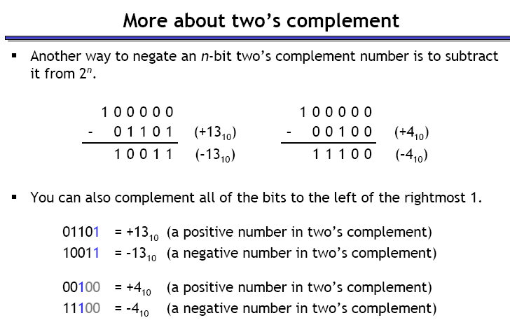

Slide 17
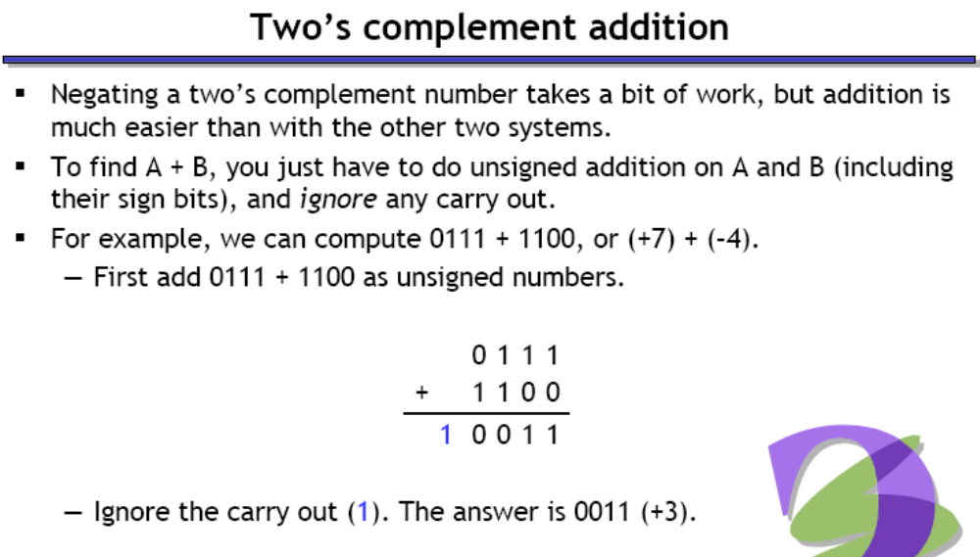


Slide 18
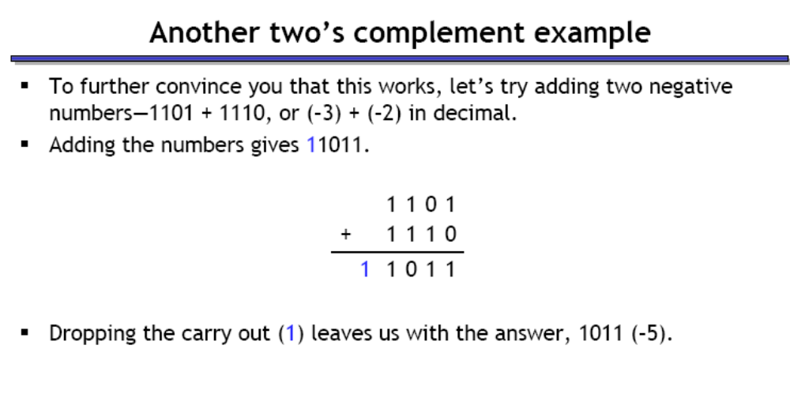

Slide 19
Advantages of Two’s Complement Notation
It is easy to add two numbers.
    0 0 0 1 +1 1 0 0 0 -8
    0 1 0 1 +5 0 1 0 1 +5
+
+
0 1 1 0 +6 1 1 0 1 -3
Subtraction can be easily performed.
Multiplication is just a repeated addition.
Division is just a repeated subtraction
Two’s complement is widely used in ALU

Slide 20
Example- 10101 in Two’s Complement
The most significant bit is 1, hence it is a negative number.
    Corresponding + number is 01011 = 8 + 2+1 = 11
    the result is then –11.

Slide 21
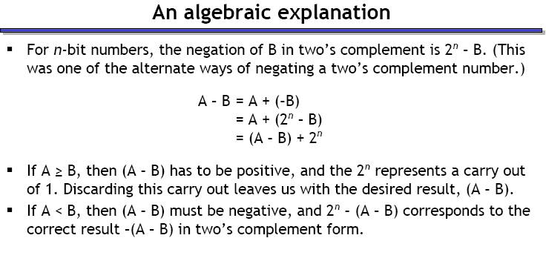

Slide 22
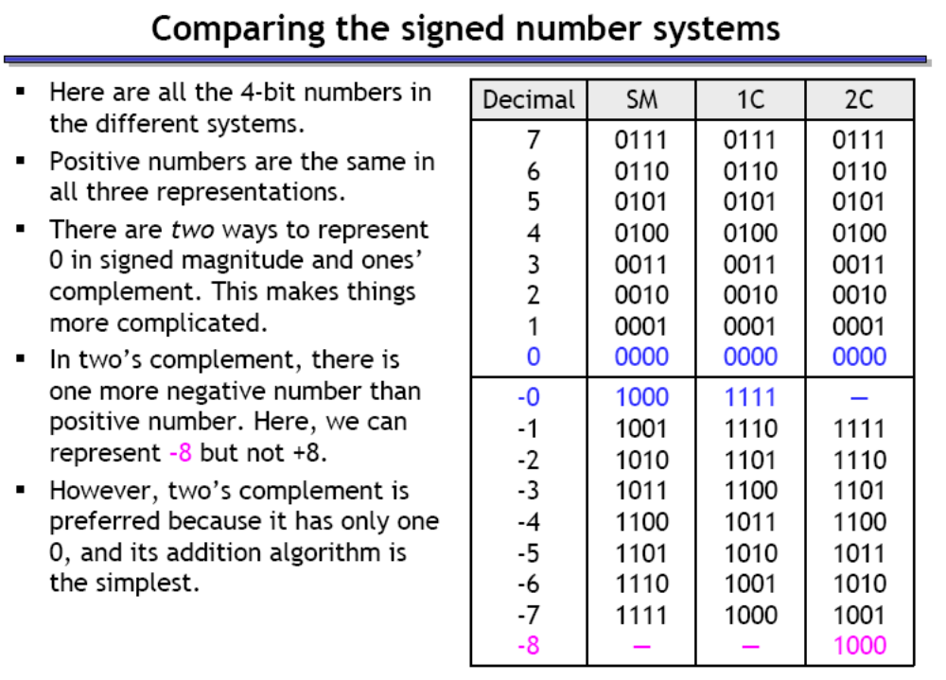

Slide 23
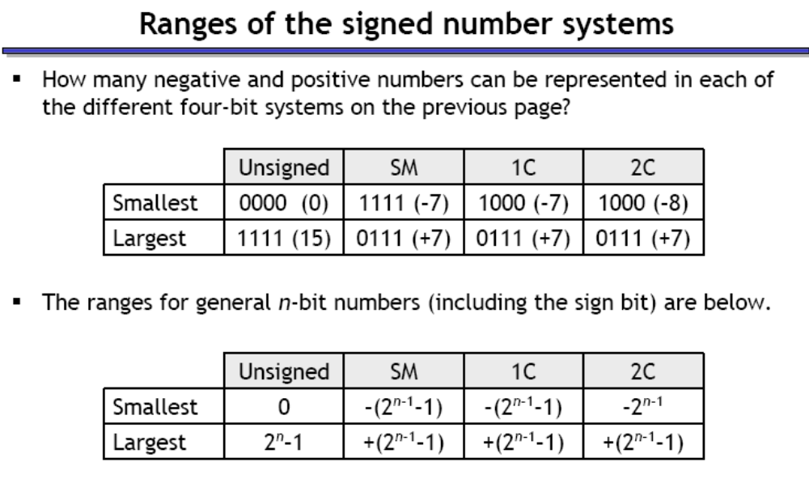

Slide 24
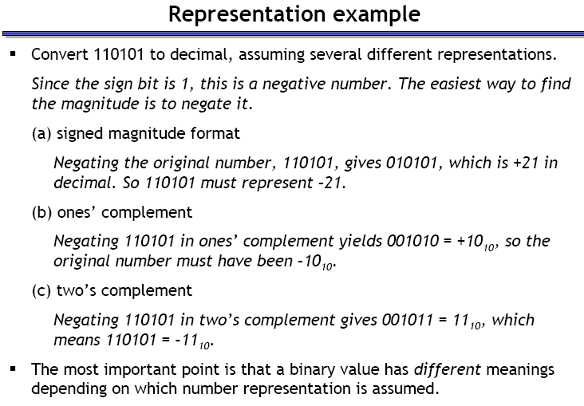

Slide 25
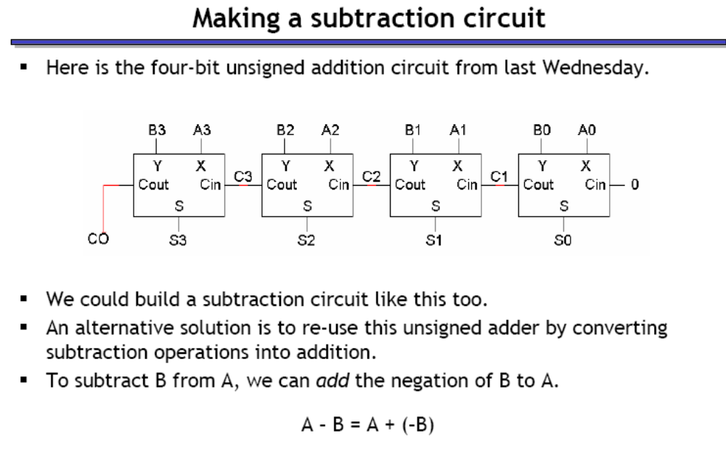

Slide 26
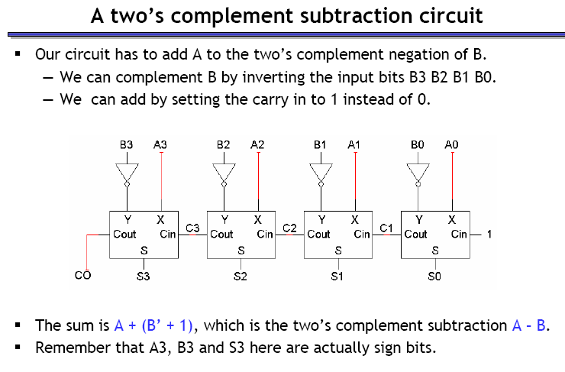

Slide 27
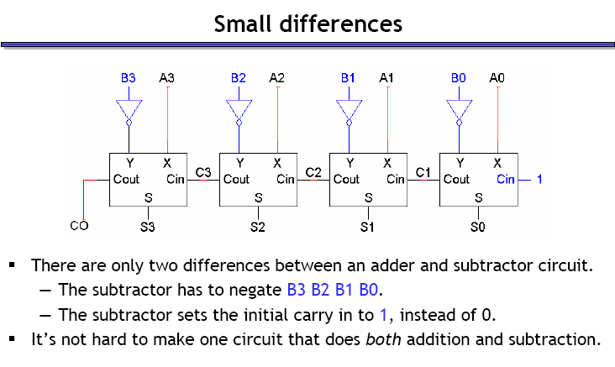

Slide 28
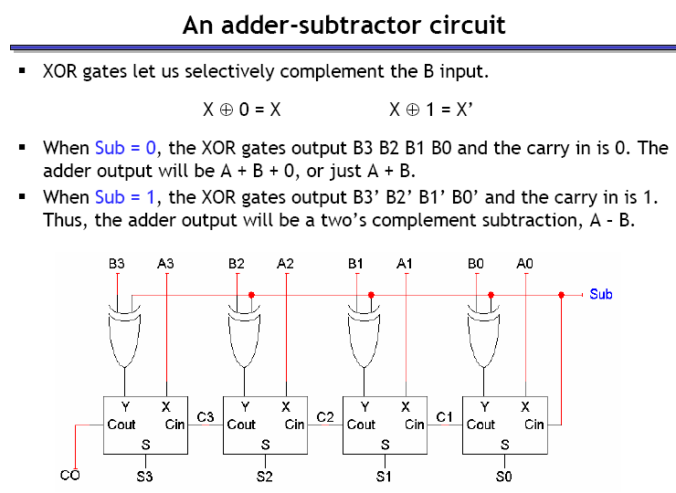
For Review

Slide 29
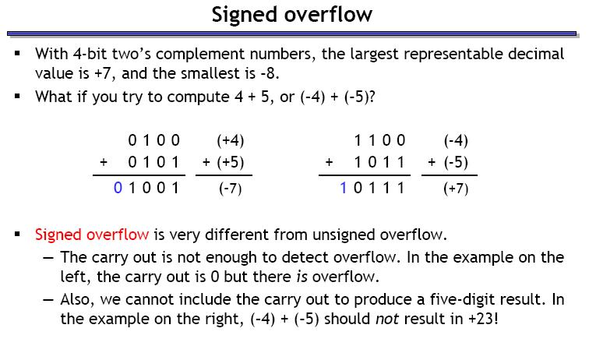
For Review

Slide 30
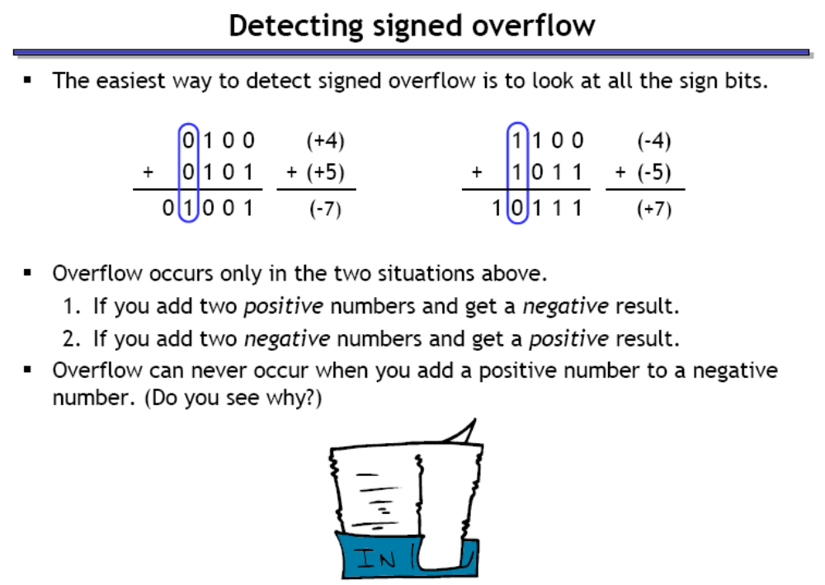
For Review

Slide 31
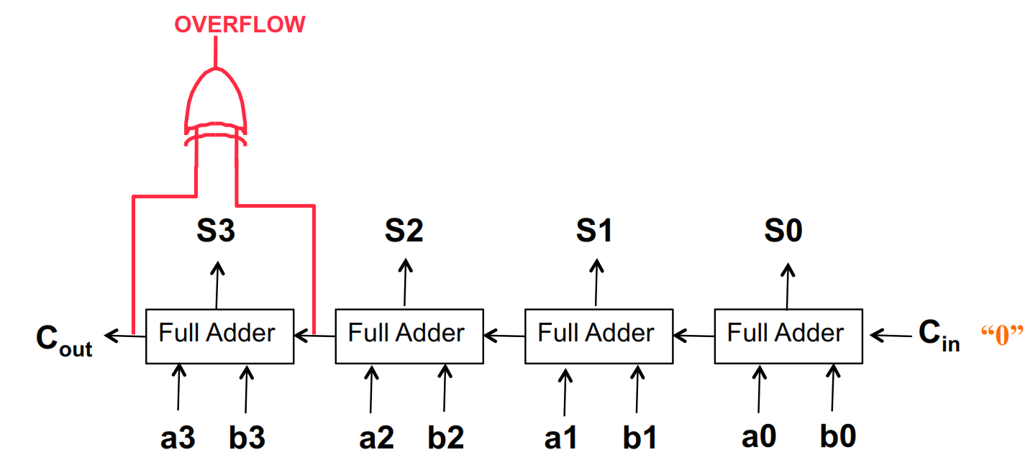

Slide 32
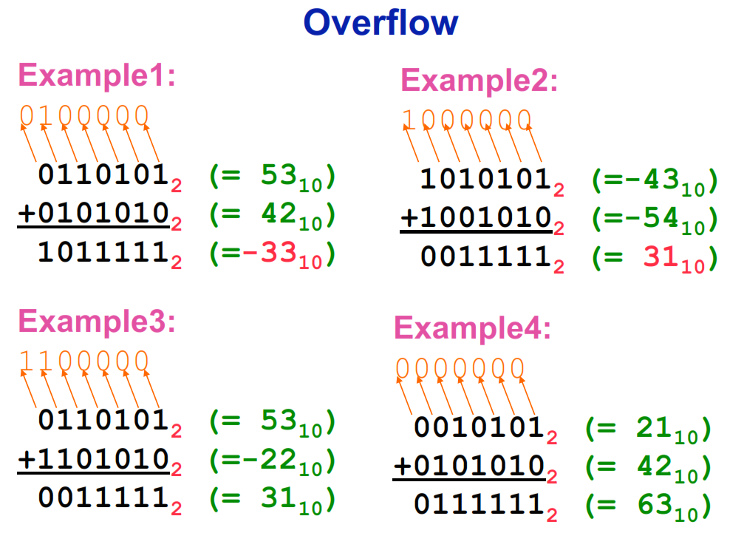

Slide 33
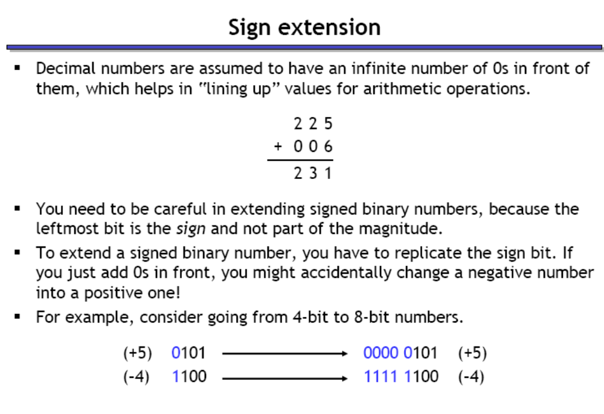
For Review

Slide 34
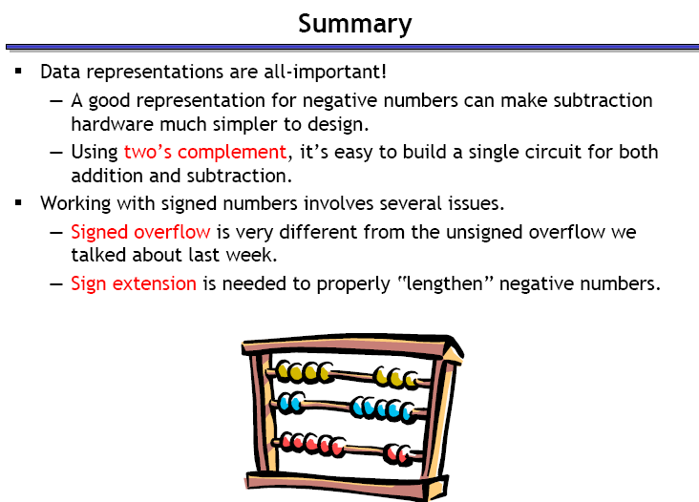
For Review

